Slide 1
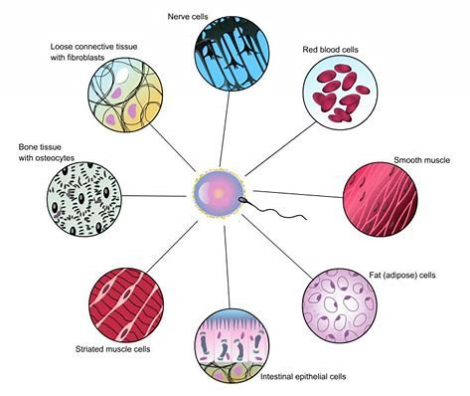
Daily Review
The human body contains about 50 trillion cells and more than 200 different types of cells.
List four different types of cell within the human body.
(Do not erase these)
Cells also have specialised structures to help them carry out a certain function.
For each of the cells you listed above, explain how they are specialised to carry out their roles.

Slide 2
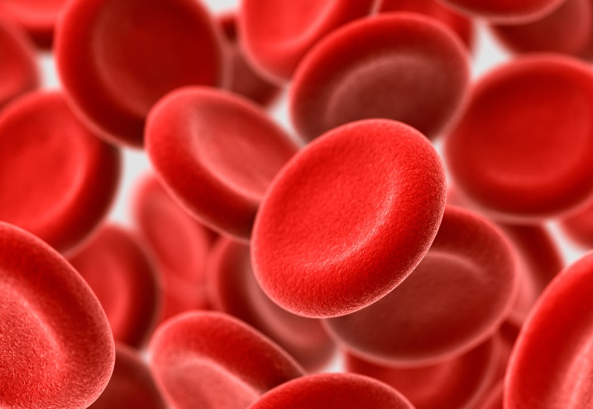
Daily Review
Identifying types of specialised cells
CFU 1
What type of cell is this?
CFU 2
What adaptations does it have?
This is a red blood cell (erythrocyte).
It has no nucleus and is biconcave in shape to help carry oxygen.
Red blood cells carry oxygen around the body.
CFU 3
What is the function of the cell?

Slide 3
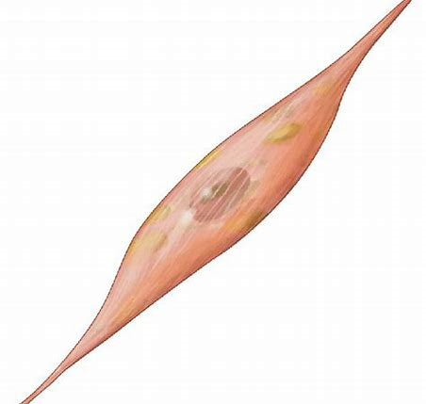
Daily Review
Identifying types of specialised cells
CFU 1
What type of cell is this?
CFU 2
What adaptations does it have?
This is a muscle cell (myocyte).
It has many mitochondria to provide it with a large amount of energy. It also has a long, tubular shape to help it contract.
Muscle cells help move the bones of the skeleton.
CFU 3
What is the function of the cell?

Slide 4
Specialised Plant Cells

Slide 5
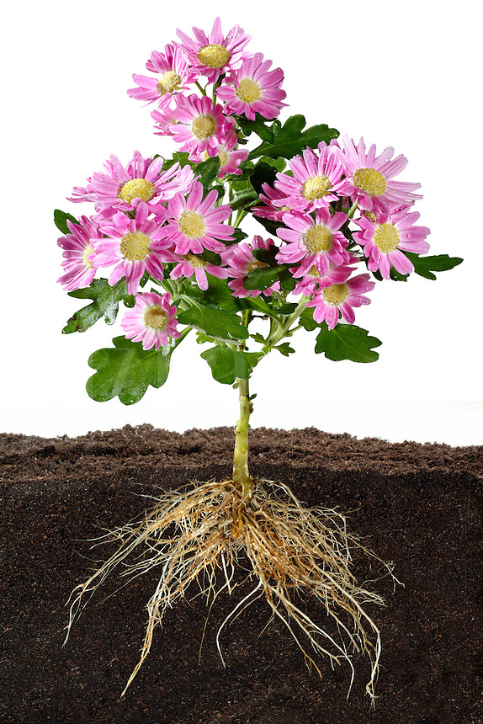
Learning Objectives
CFU
What are we going to learn?
Identify and describe the function of specialised cells in plants.
Activate Prior Knowledge
Plants have many parts that allow it to perform the 7 characteristics of living things.
On your whiteboard, name as many parts of the plant shown on the right as you can.

Slide 6
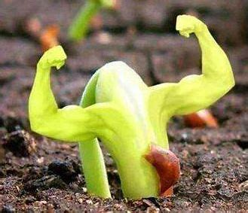
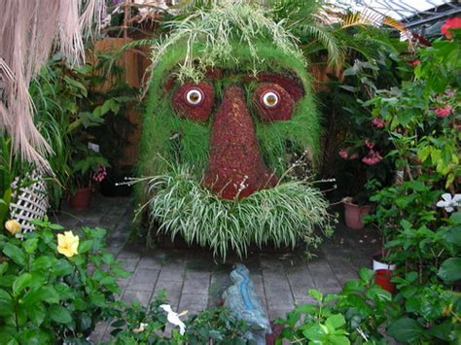
Concept Development
CFU 1
True or False: Plants are multicellular organisms. Explain your answer.
Cells in Plants
Like humans and animals, plants contain cells of many shapes, structures, and sizes.
Each type of cell is specialised to carry out a different function within the plant.

Slide 7
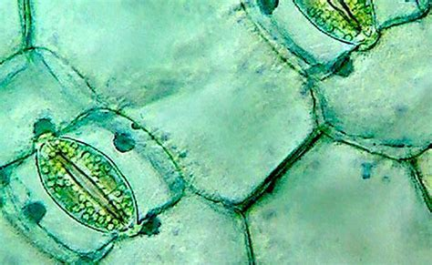
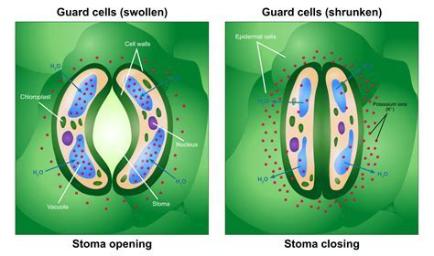
Concept Development
CFU 3
Think, Pair, Share: Which gases do plants exchange?
CFU 1
What is the function of guard cells?
Guard Cells and Stomata
Guard cells are found on the leaves and stems of plants.
Guard cells work in pairs to open and close very tiny pores (or holes) in the leaves called stomata (stoma is singular).
Gases needed by the plant enter through open stomata and unwanted gases leave the same way.
Guard cells also close the stomata when plants need to reduce water loss.
CFU 2
Explain what stomata are.

Slide 8
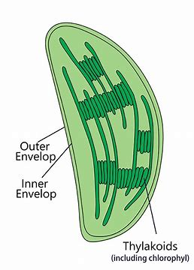
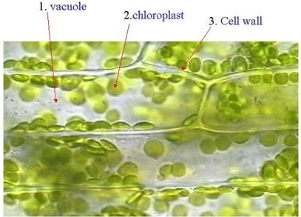
Concept Development
CFU 1
Why do the cells near the surface of leaves contain chloroplasts?
Photosynthetic Cells
Cells near the surface of the green parts of stems and leaves have large numbers of chloroplasts.
Chloroplasts contain the green chemical called chlorophyll.
Chlorophyll traps the Sun’s energy, which the plant then uses in photosynthesis.
Plant cells that are not exposed to sunlight, such as those in the roots, do not contain chloroplasts and are not green.
CFU 2
What is the function of chlorophyll?
CFU 3
Which parts of plants do not contain chloroplasts? Why not?

Slide 9
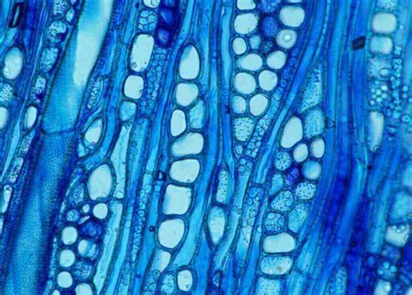
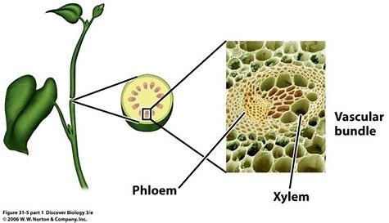
Concept Development
CFU 1
How does water pass from the roots of a plant to its leaves?
CFU 2
What is sent from the leaves to the roots?
Conducting Cells
Plants take in water from the soil through their roots. This water is needed in the leaves for photosynthesis.
The water is transported from the roots to the leaves through conducting cells in the stem.
The food made through photosynthesis then needs to return to the roots and stem for the plant to stay alive.
This food is also transported down the plant in the conducting cells.
The conducting cells are specialised for transporting water and food.
They are long thin tubes, like drinking straws.

Slide 10
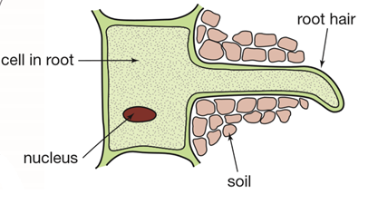
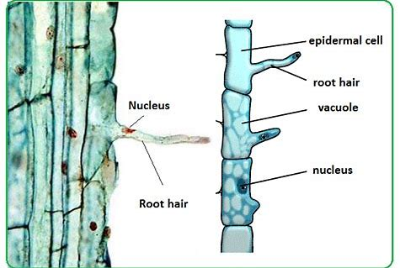
Concept Development
CFU 1
Why would only the cells on the outer surface of roots have root hairs?
Root Hairs
Water comes into plants from the soil through their roots.
Cells on the outer surface of the roots of plants have extensions called root hairs.
These root hairs increase the surface area of the root by a large amount.
An increased surface area means that there is more root surface in contact with the soil, so the more water the plant can take in.
CFU 2
What is the role of root hairs?
CFU 3
Why does increased surface area benefit the plant?

Slide 11
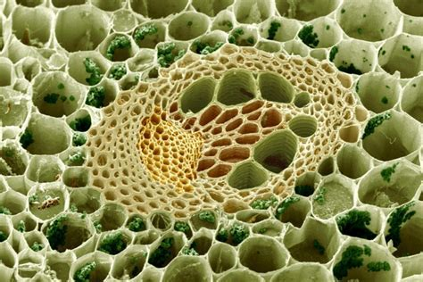
Concept Development
CFU 1
How do cell walls benefit plants?
CFU 2
True or False: The bark of a tree is just dead plant cells.
Structural Cells
The cell walls act as the skeleton of plants.
When plants grow they become bigger and heavier. Then their skeleton needs to get stronger.
The cell walls of many cell types, especially the water-conducting cells in the plant stem, become thicker and stronger, providing more support.
The wood of tree trunks is mostly cells with walls that are so thick that the cell has died. The living part of a tree trunk is just below the bark.
CFU 3
Think, Pair, Share: Will removing the bark from a tree cause it damage? Why/why not?

Slide 12
Skill Development/Guided Practice
Collect and complete a graphic organiser using the information on the following slides.

Slide 13
Skill Development/Guided Practice
Write this down on your worksheet.
Identifying types of specialised plant cells
CFU 1
What type of cell is this?
CFU 2
What adaptations does it have?
This is a root hair cell.
It increases the surface area of the roots of a plant.
This allows more water and nutrients to be absorbed into the roots of the plant.
CFU 3
What is the function of the cell?

Slide 14
Skill Development/Guided Practice
Write this down on your worksheet.
Identifying types of specialised plant cells
CFU 1
What type of cell is this?
CFU 2
What adaptations does it have?
This is a guard cell.
Guard cells work in pairs to open and close stomata in the leaves of plants.
This allows carbon dioxide to enter and oxygen to leave the plant.
It also assists in water retention.
CFU 3
What is the function of the cell?

Slide 15
Relevance
Knowing how organs work together in a system and how the systems interact with each other will help you understand how the body works.
Understanding the structure and function of plant cells will help you understand how plants obtain their food and provide us with oxygen.

Slide 16
Skill Closure
Why do plants contain different types of cells?
Skill Closure
Plant Cell Function
1 Root Hair A Open and close stomata on leaves for gas exchange
2 Guard Cell B Absorbs sunlight for photosynthesis
3 Chloroplast C Transports water to leaves, and food to roots of plant
4 Structural Cell D Provide support for the plant
5 Conducting Cell E Increases surface area of roots to absorb water

Slide 17
Independent Practice
Complete the remaining sections of your graphic organiser using the information below.
Chloroplast Contains chlorophyll Absorbs sunlight to aid photosynthesis in the plant. Photosynthesis allows plant to make their own food. | Structural Cell Strong, thick cells. Harden and provide support for a plant. Bark on trees is dead structural cells.
Conducting Cell Long, tubular cells. Transport water from the roots to the leaves of a plant. Transports food (glucose) from the leaves to the roots of a plant.

